Slide 1

INC 5000 Analysis
Fast-Growing Private Companies in America
2019 Dataset Analysis
A comprehensive study of industry trends, geographic distribution, and growth patterns among the nation's most dynamic private businesses.

Slide 2

Executive Summary
5,000
29
50
Companies Analyzed
Industries Covered
States Represented
The core of our extensive 2019 dataset.
Diverse sectors driving U.S. economic expansion.
A nationwide snapshot of private sector dynamism.
Average company revenue: $45.2 Million
Highlighting substantial financial impact.
Most represented industry: Business Products & Services (492 companies)
A cornerstone of the private sector.
Highest average revenue sector: Health ($109.3M)
Demonstrating robust financial performance.
Fastest growing sector: Logistics & Transportation (717.6% growth)
Indicating significant market demand and expansion.

Slide 3






Q1: Average Revenue by Industry
Security
Health
Logistics & Transportation
$123.7M avg
$109.3M avg
$101.3M avg
Security: $123.7M avg
Health: $109.3M avg
Logistics & Transport: $101.3M avg
Energy: $80.2M avg
Human Resources: $73.6M avg
Consumer Products: $72.1M avg
Retail: $66.6M avg
Government Services: $59.4M avg
Insurance: $58.7M avg
Construction: $58.4M avg

Slide 4

Q2: Industry Representation (5,012 Total Companies)
Top 8 Industries
Next 7 Industries
Business Products & Services: 492
Government Services: 236
Advertising & Marketing: 489
Real Estate: 198
Software: 461
Logistics & Transport: 186
Health: 356
Manufacturing: 181
Construction: 350
Retail: 163
Consumer Products: 315
Human Resources: 157
IT Management: 276
Food & Beverage: 127
Financial Services: 239
✓ Top 3 industries = 1,442 companies (28.8%), demonstrating strong market presence. Business Products & Services plus Advertising & Marketing together account for 981 companies (19.6%), underscoring their critical roles in the ecosystem.

Slide 5
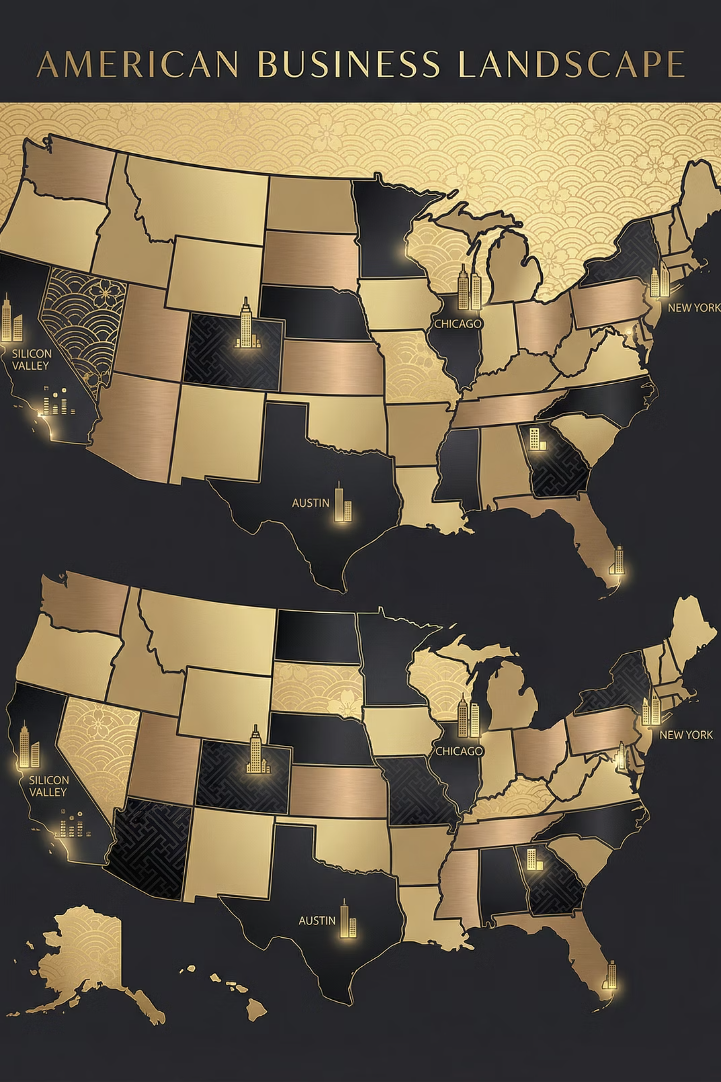
Q3: Geographic Distribution (5 Major Zones)
Zone Totals
Top States by Zone
West: 1,828 (36.5%)
West: CA (712), TX (467), CO (156), UT (123)
South: 1,417 (28.3%)
Northeast: 890 (17.8%)
South: FL (385), GA (219), VA+DC (180+), LA (111)
Midwest: 650 (13.0%)
Other: 227 (4.5%)
Northeast: NY (249), MA (186), PA (137), NJ (126)
Midwest: IL (261), OH (170), MN (156), IN (133)
✓ The West and South collectively account for 64.8% of all INC 5000 companies, highlighting key regional hubs. California leads all states with 712 companies, showcasing its dominant entrepreneurial landscape.

Slide 6





Q4: Top Industries by Average Growth % (All 15 Listed)
Logistics & Transport
717.6%
Consumer Products
685.6%
Food & Beverage
668.2%
Computer Hardware
652.0%
Energy
592.1%
✓ Logistics & Transportation leads all sectors with an impressive 717.6% growth, significantly exceeding the average by 262%. The top three sectors (Logistics, Consumer Products, and Food & Beverage) all demonstrate exceptional growth rates above 668%, primarily driven by booming e-commerce and evolving supply chain dynamics.

Slide 7

Q5: Top 5 & Bottom 5 Companies by Staff Change
Top 5 Hiring 🚀
Bottom 5 Reducing 📉
Allied Universal
IDS International
+118,531 workers | $5.8B revenue
-682 workers | +64% growth
Alorica
Prime Therapeutics
+43,000 workers | $2.2M revenue
-600 workers | +390.6% growth
Infiniti HR
Akorbi
+37,145 workers | $458M revenue
-300 workers | +68.1% growth
CircusTrix
First American
+13,739 workers | $194.1M revenue
-243 workers | +77.1% growth
ScribeAmerica
Integrity Services
+11,641 workers | $305.1M revenue
-150 workers | +72.2% growth

Slide 8



Q6: Companies Growing Revenue + Reducing Staff
96
1.92%
-3,742
Total Companies
% of INC 5000
Combined Staff Loss
An elite group demonstrating strategic efficiency.
A significant minority achieving this dual feat.
Reflecting streamlined operations and automation.
Top Examples (Efficiency & Automation)
1
2
Prime Therapeutics
IDS International
$21.4B, -600 workers, +390.6% growth
$44.7M, -682 workers, +64% growth
3
4
Akorbi
First American
$39.3M, -300 workers, +68.1% growth
$783.9M, -243 workers, +77.1% growth
✓ This unique trend signals operational excellence, where growing revenue while reducing staff points to successful automation, efficiency gains, and process optimization strategies. 96 companies exemplify this mastery.

Slide 9

Q7: "Winner State" - Top 1000 Companies
🏆 CA
2. TX
170 Companies (17%)
82 Companies (8.2%)
3. NY
79 Companies (7.9%)
Complete Top 15 States (Top 1000)
1. California: 170
9. Colorado: 34
2. Texas: 82
10. Pennsylvania: 28
3. New York: 79
11. North Carolina: 26
4. Florida: 78
12. Utah: 26
5. Virginia: 62
13. Washington: 23
6. Georgia: 44
14. New Jersey: 22
7. Illinois: 43
15. Ohio: 21
8. Maryland: 36

Slide 10






Q8: Companies Founded in 2018 in Top 100?
❌
ANSWER: NO
Zero companies founded in 2018 achieved a spot on the prestigious Top 100 INC 5000 list.
Why?
Top 100 ranking typically demands 3-5+ years of robust operational history and sustained growth.
History
Companies founded in 2018 had only one year of verifiable history by the 2019 data collection cut-off.
Top 100 Demands
Requires $50M+ in revenue, 10%+ annual growth, and a proven, scalable business model.
Path to Elite Status
The earliest typical path to the Top 100 is generally 4-5 years, allowing for market maturity and significant scale.

